Slide 1
Weather app project FA-4 Evaluation
Created by using React Js and Bootstrap

Slide 2
INTRODUCTION
We aimed for creating a Web-React-application, using all the necessary languages we were asked to do.
Our project is titled as “Weather-App”, which does the basic work of manifesting weather details of the specified place. We tried to have the outlook of the website as neat and clear as possible.

Slide 3
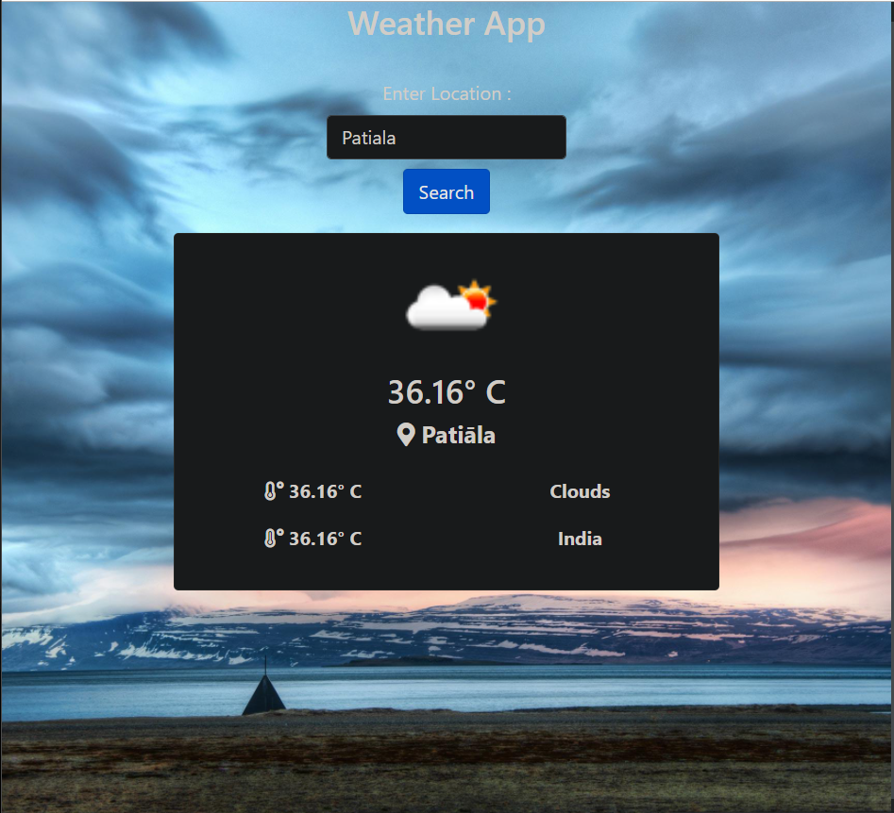
OBJECTIVE
The basic layout/working of our web application is as follows:-

Slide 4
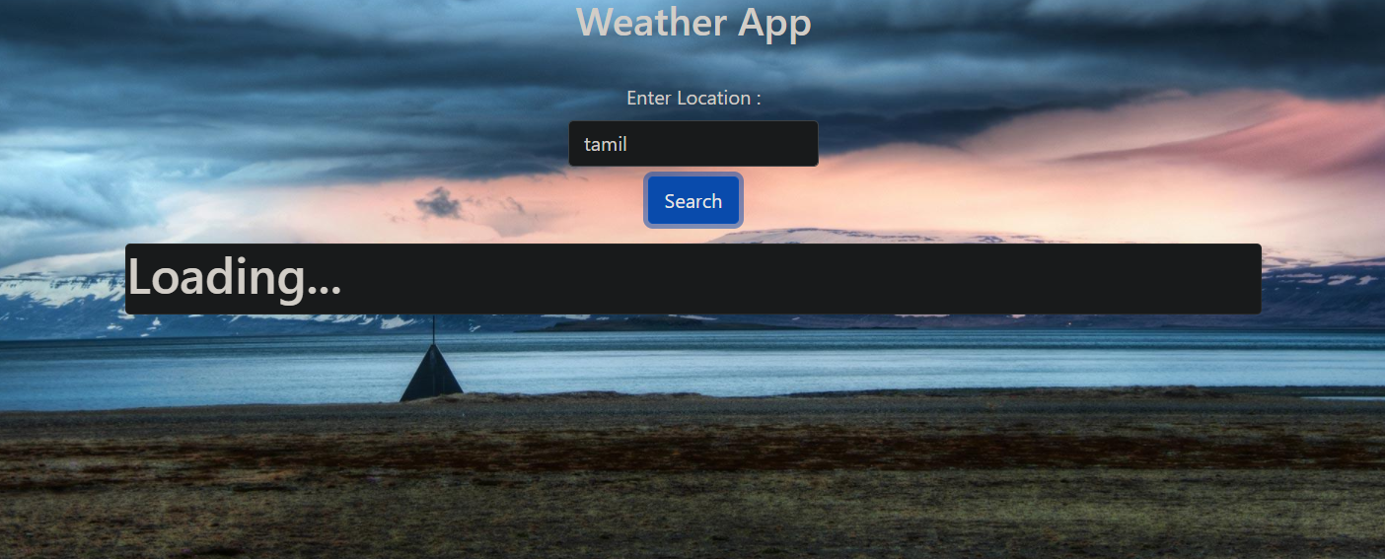
Unable to find a non-existing location

Slide 5
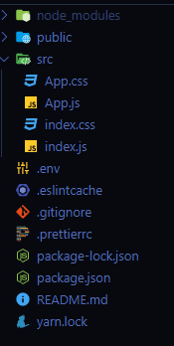
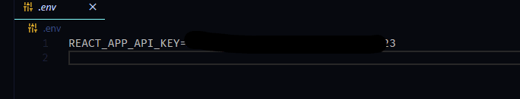
BUILDING DESCRIPTION
After opening the project file on VS Code, We generated an API key for our weather app. We stored the api file as followed:-

Slide 6
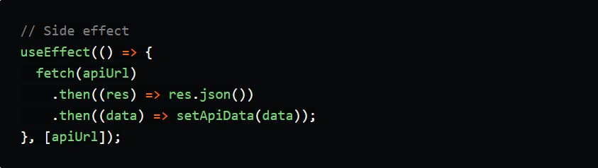
Then we made an api request using fetch and useEffect Hook.
The useEffect hook is used to perform side effects on our app, it fetches the data from the given api url and stores in apiData state.This happens only when apiUrl changes thus it will prevent unwanted re-render. [] this is the dependency array this determines when to re-render a component, when it is left empty it'll render only once.

Slide 7
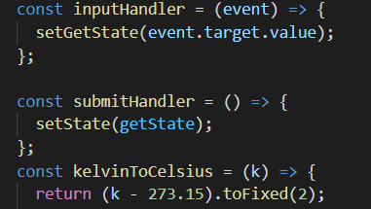
We created some functions then:-
inputHandler this function is used to handle the input field, to get the data and store in getState.
submitHandler this function is used to copy the state from getState to state.
kelvinToCelsius this function is used to convert kelvin to celsius, since we get the data from api as kelvin we're using this function.

Slide 8
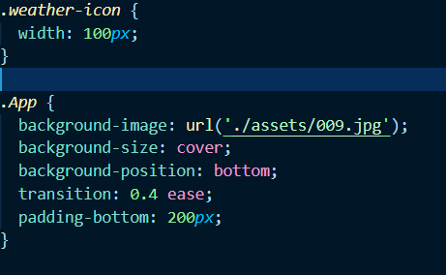
We added background images and stuff to make it look more alluring by importing pictures sources:-

Slide 9

We used bootstrap for styling, the rest of the code is pretty self explanatory and use of functions. We're displaying the data from the apiData state object by accessing it's keys.

Slide 10
CONCLUSION
From that all we achieved, We managed to make a web app to display weather of any specified place. We used objects and keys to access data from the api to display as per the input locations.
This being a very basic website about the Weather report solves common understanding for the celsius details about a particular location.

Slide 11
CONTRIBUTORS
Harsimran Singh(1910991024)
Anurag Mukhopadhyay(1910990877)
Sojanya Garg(1910990866)
Ayush Anand(1910990882)
PRESENTED TO:-
Dr. Bidush Kr. Sahoo
Chitkara University

